Slide 1


Instructor Resources
Chapter 6 Figures
Cover photo: BeautyStock – stock.adobe.com.

Slide 2
Chapter 6
Dedicated Aircraft Systems

Slide 3
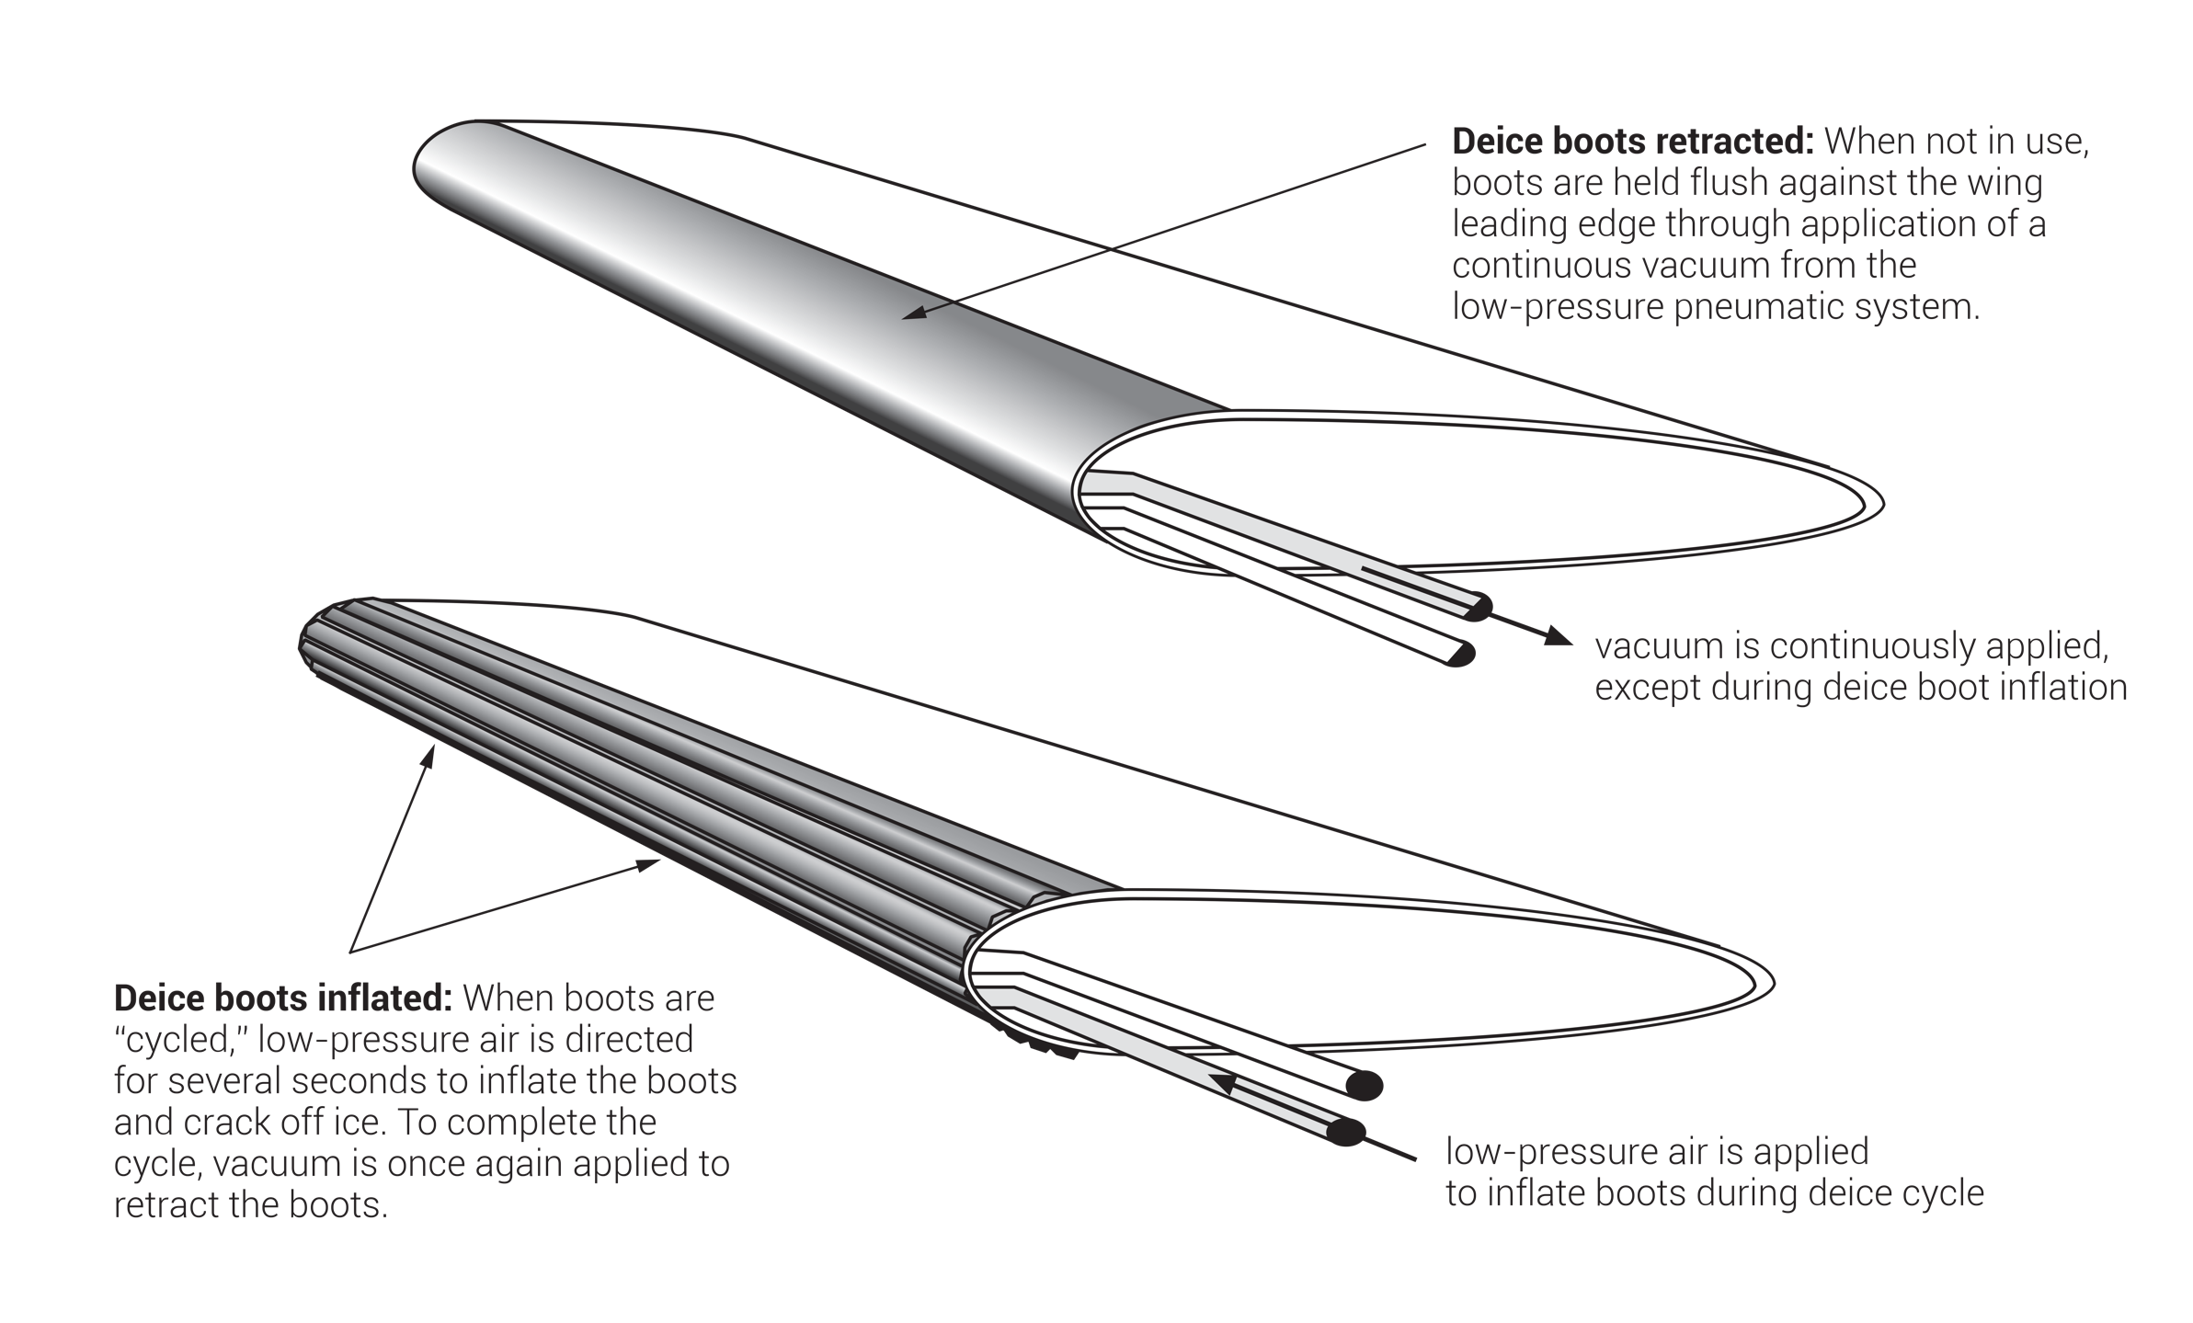
FIGURE 6.1
Pneumatic deicing boots.

Slide 4
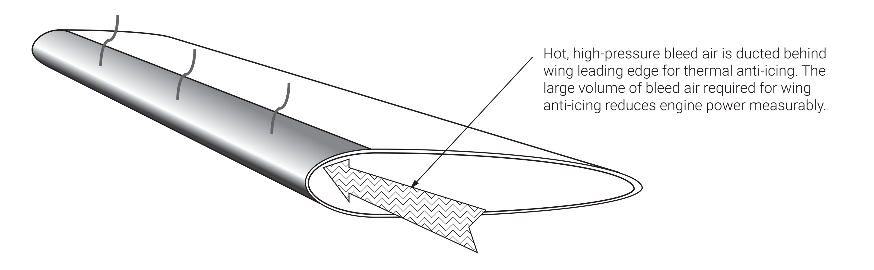
FIGURE 6.2
Thermal wing anti-ice.

Slide 5
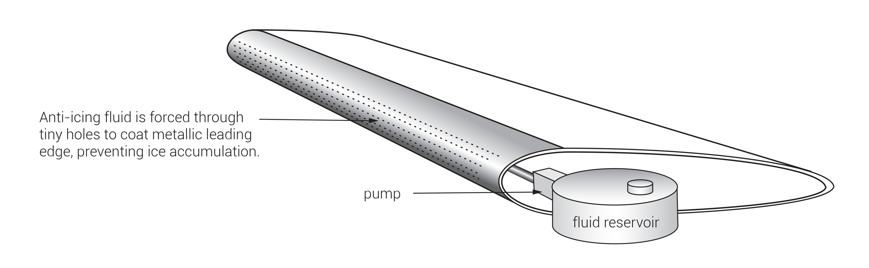
FIGURE 6.3
TKS liquid wing anti-ice.

Slide 6
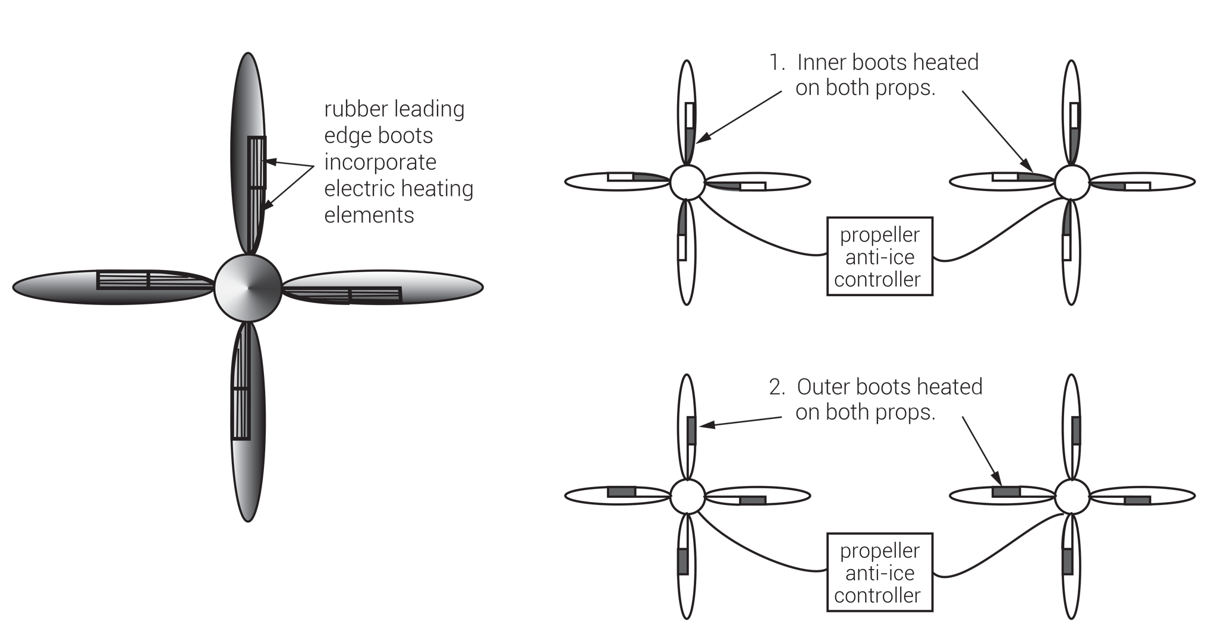
“Hot prop” anti-ice systems incorporate electric heating elements in rubber leading edge propeller boots. Due to high amperage requirements of electrical heating, all boots cannot be heated at the same time. A propeller anti-ice controller (or “timer”) sequentially cycles power to symmetrical sets of boots. An anti-ice electrical loadmeter (ammeter) is often associated with the system. Reduced or no current draw for one heating cycle indicates failed boot heating segments.
FIGURE 6.4
Electrically heated propeller anti-ice system (“hot props”).

Slide 7
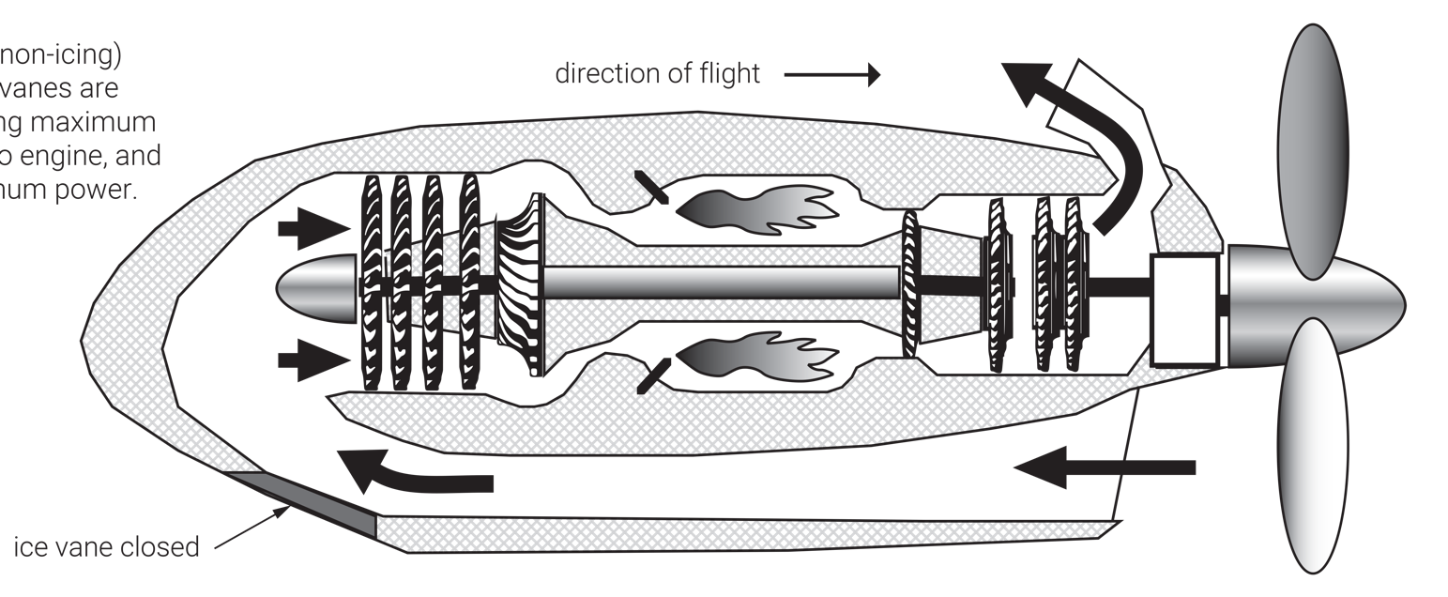
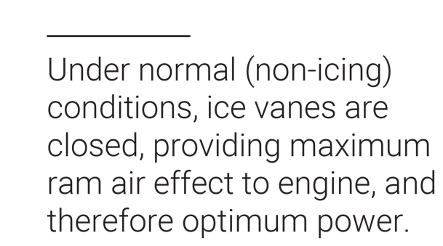
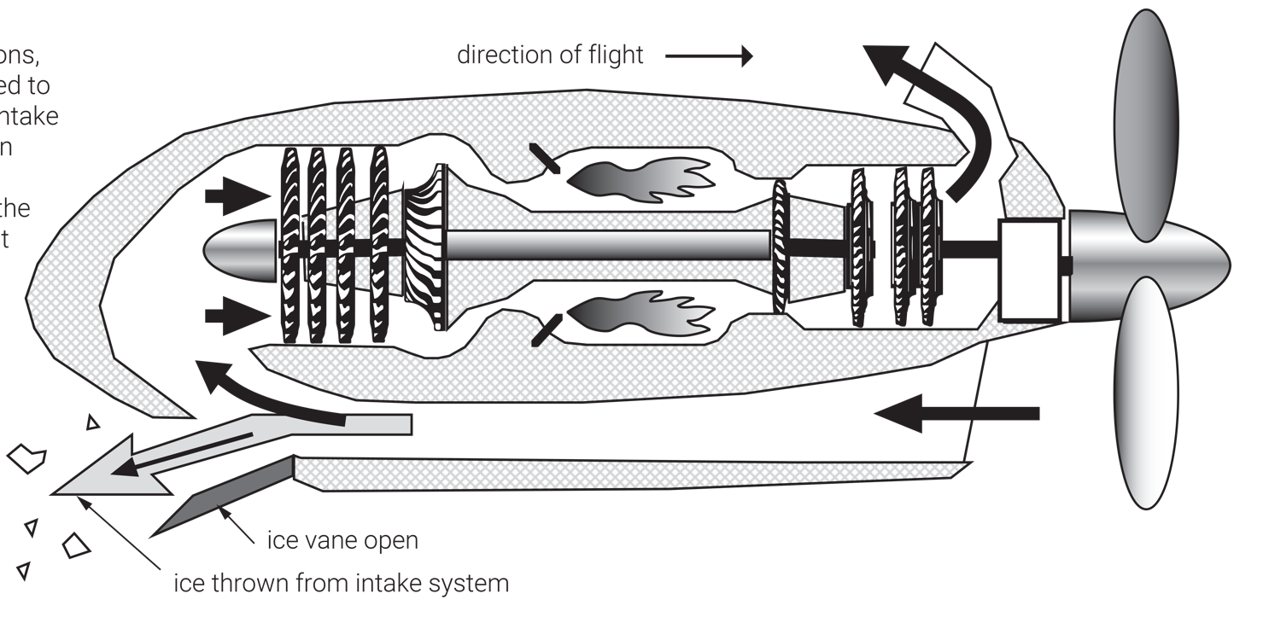
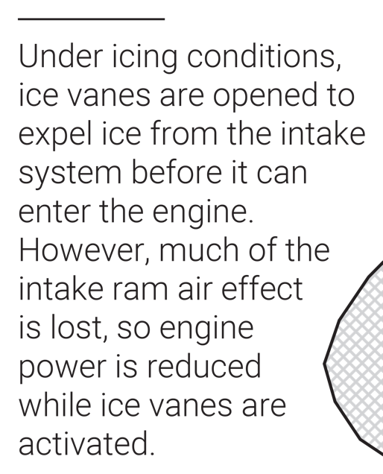
FIGURE 6.5
Inertial separator engine anti-ice system (“ice vanes” shown on a reverse-flow, free-turbine turboprop).

Slide 8
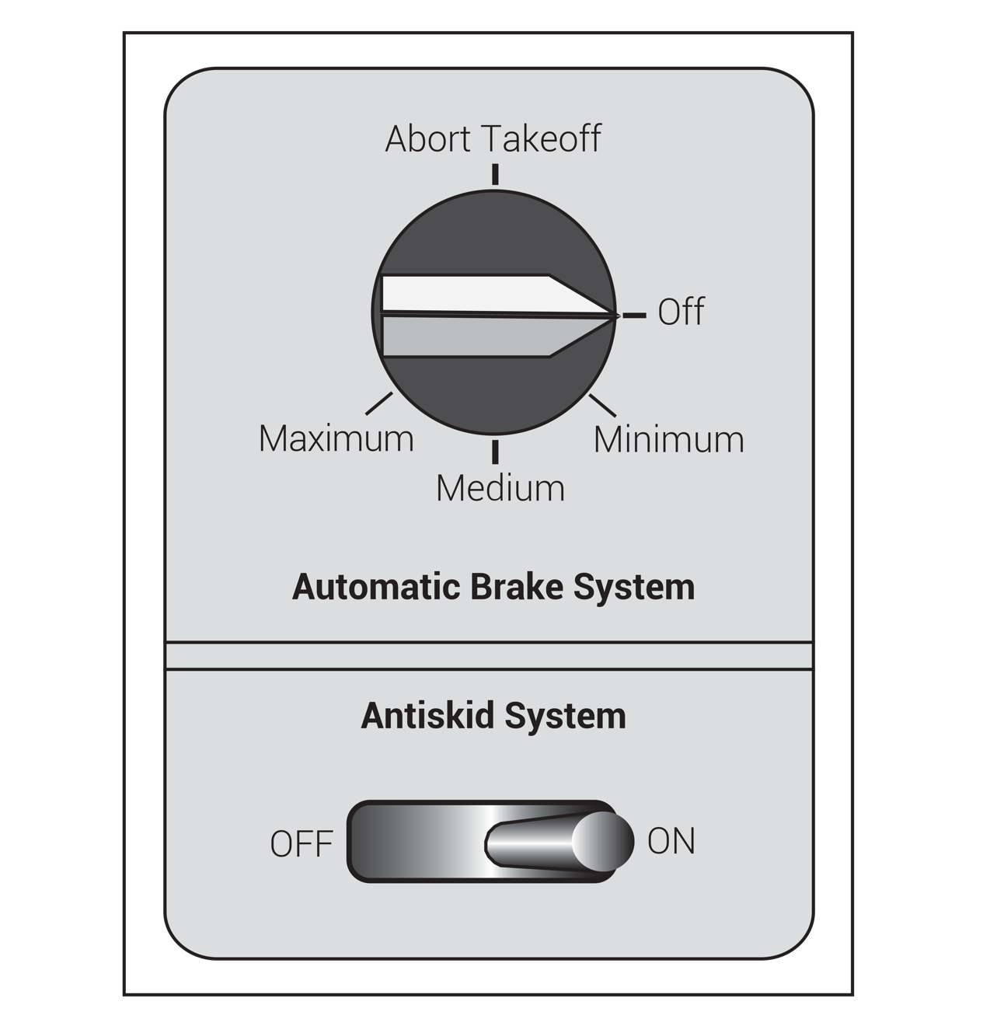
FIGURE 6.6
Automatic brake.

Slide 9
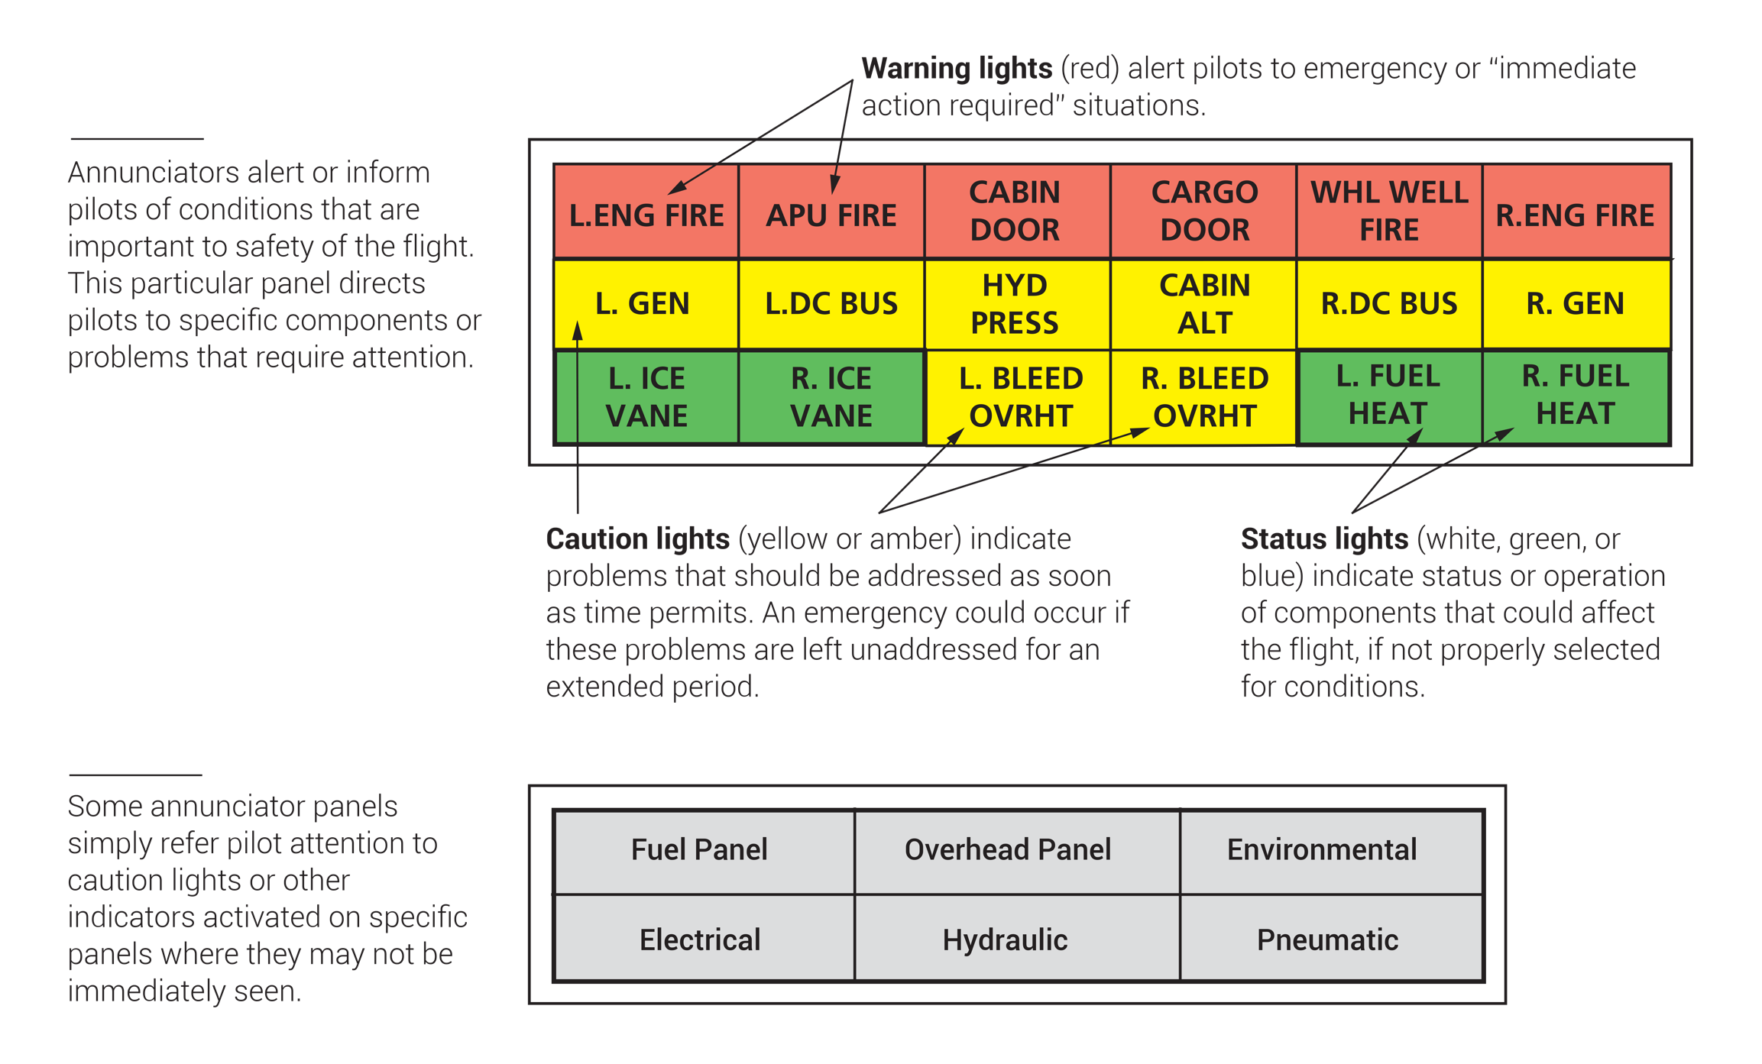
FIGURE 6.7
Annunciator or advisory panels.

Slide 10
FIGURE 6.8
Flight deck annunciator panel and lights.

Slide 11
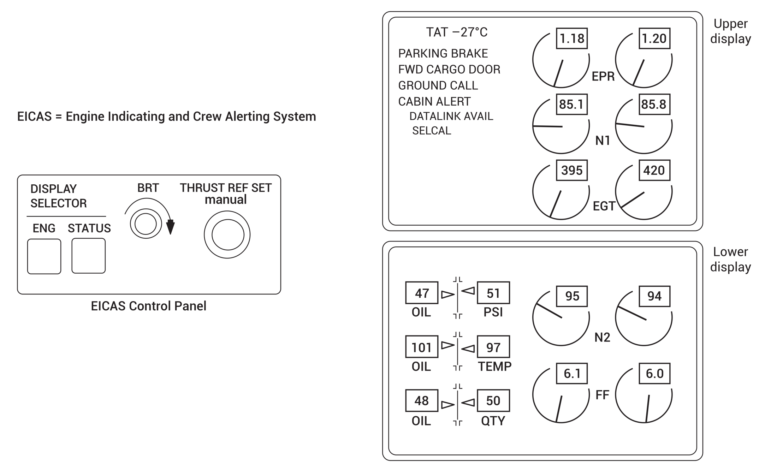
FIGURE 6.9
Engine-indicating and crew-alerting system (EICAS).

Slide 12
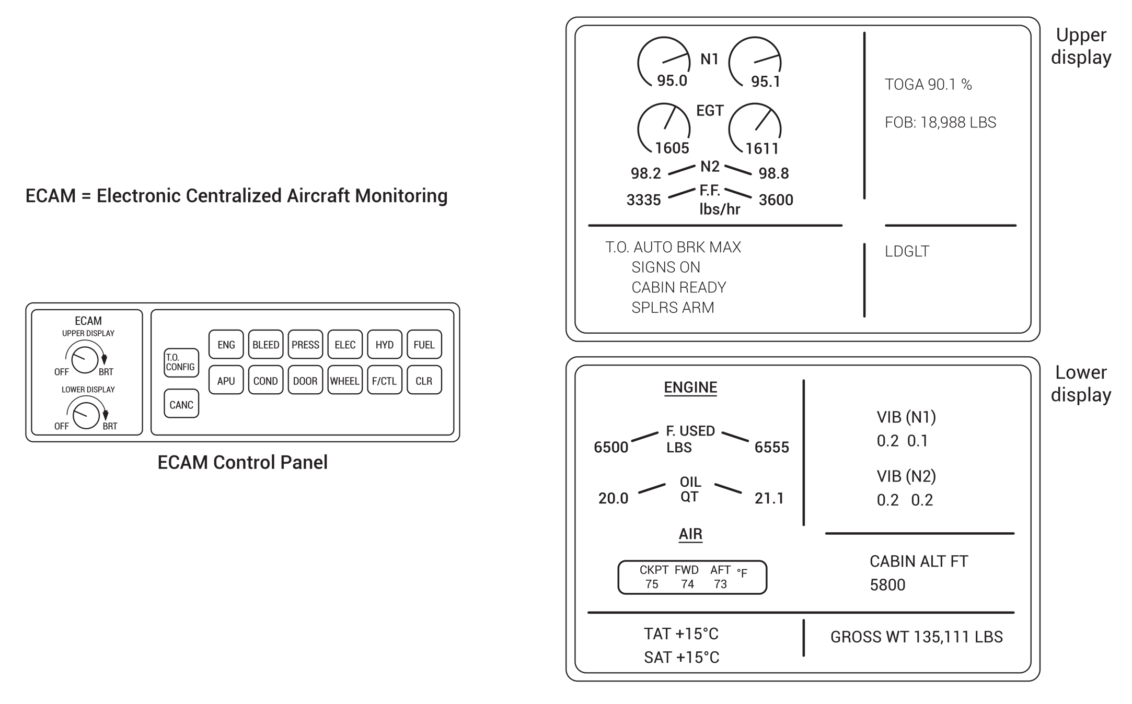
FIGURE 6.10
Electronic centralized aircraft monitoring (ECAM).

Slide 13
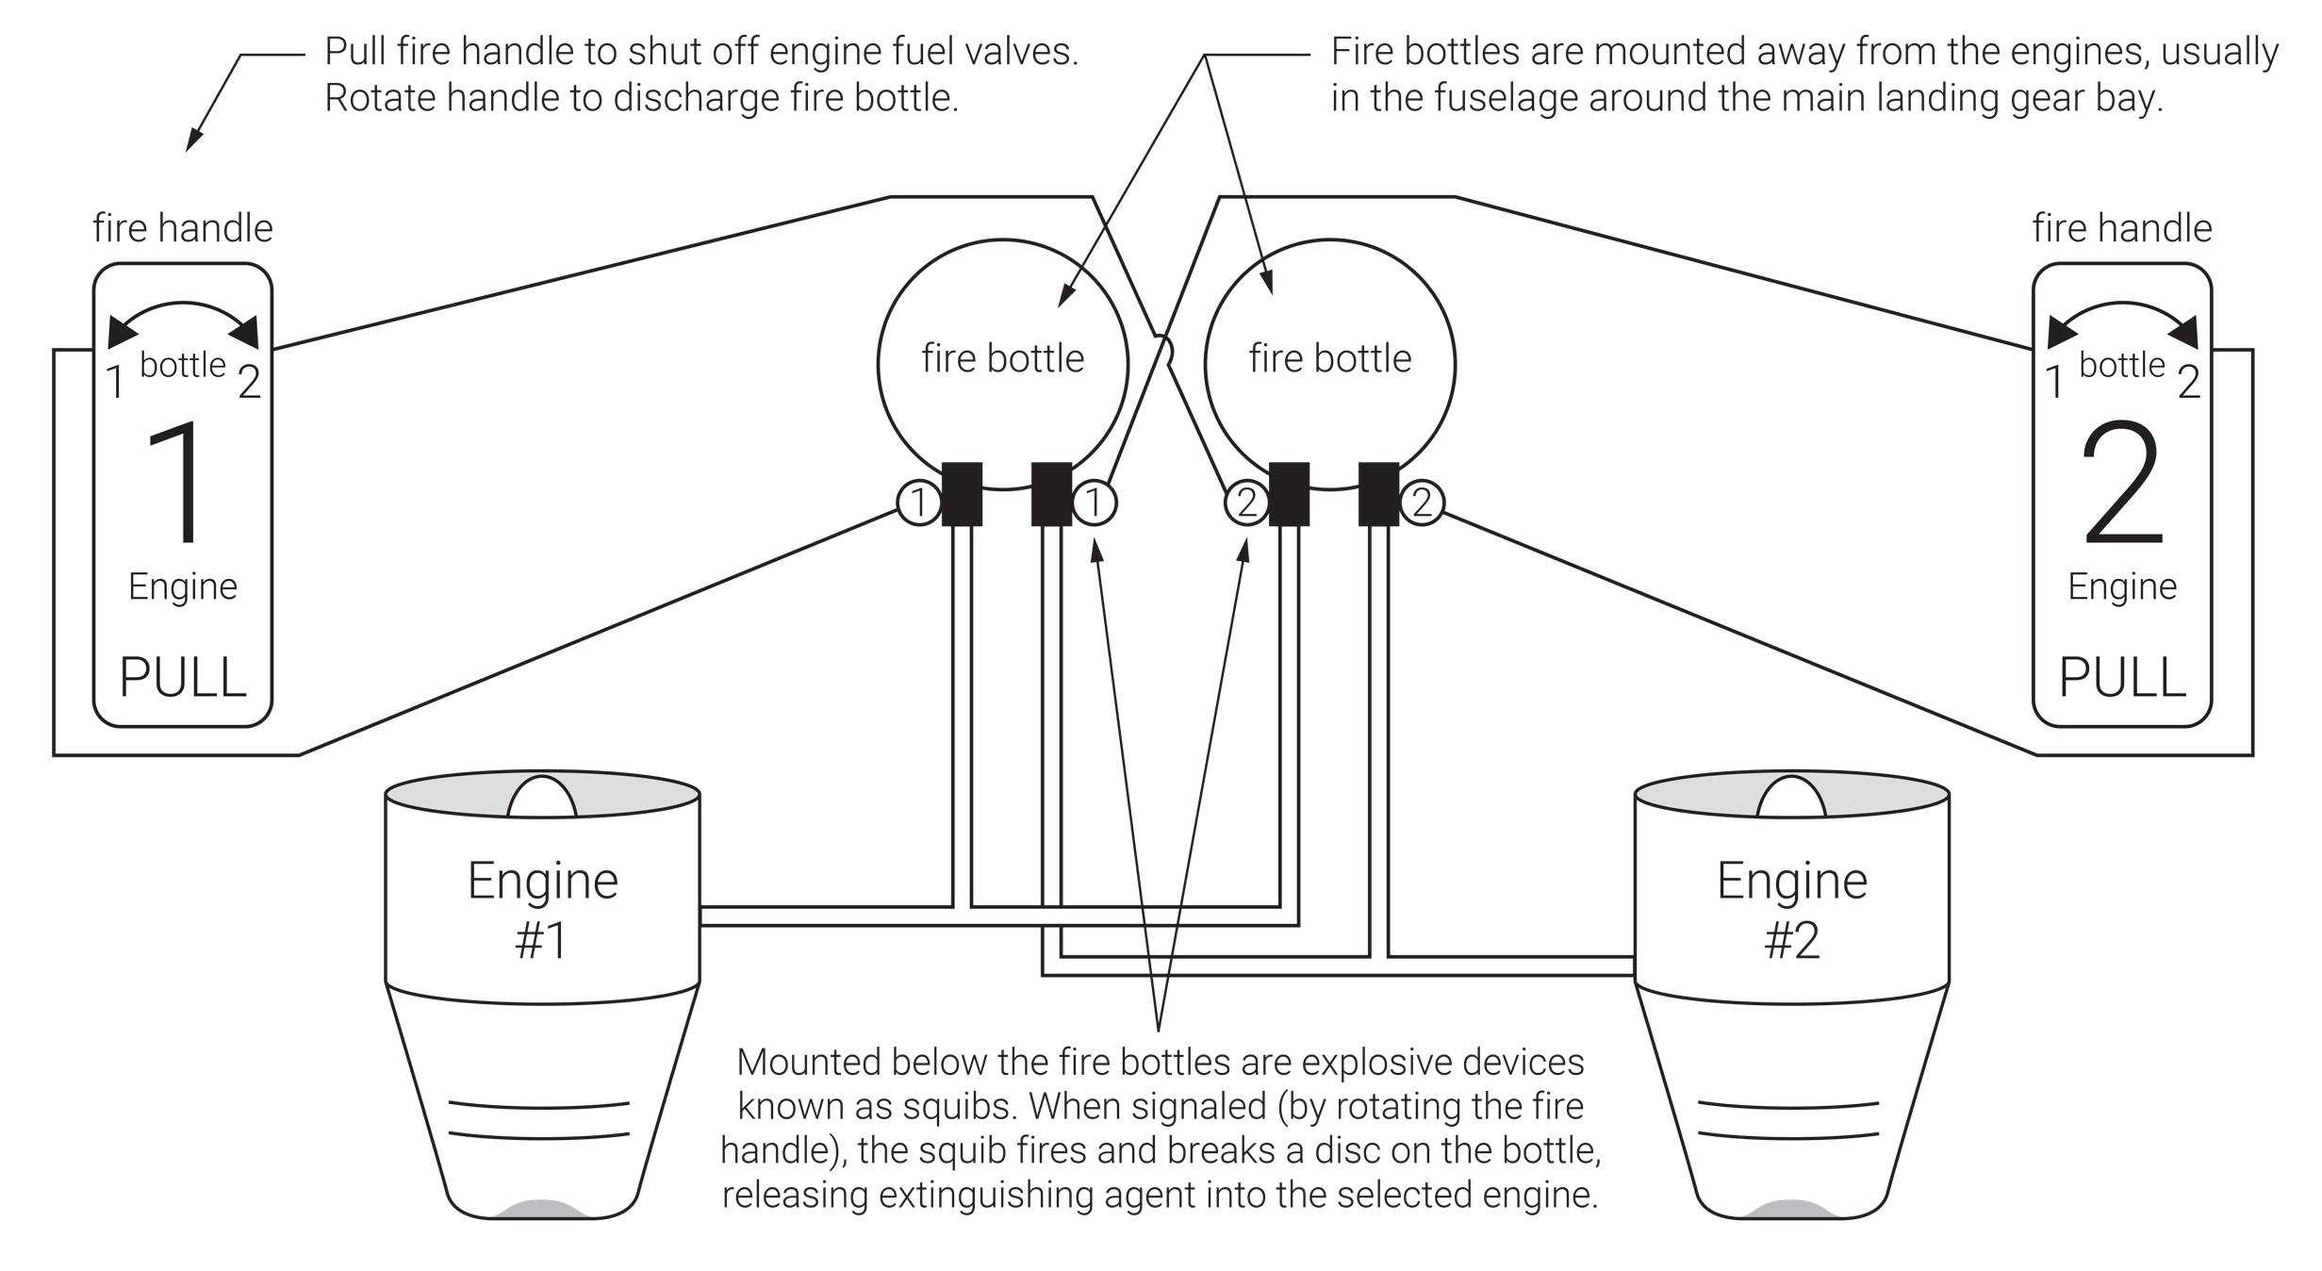
FIGURE 6.11
Engine fire suppression system.

Slide 14
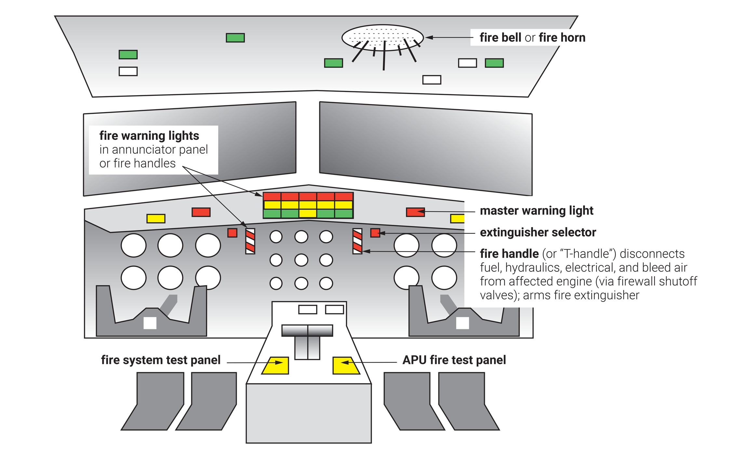
FIGURE 6.12
Fire protection system: flight deck components.

Slide 15
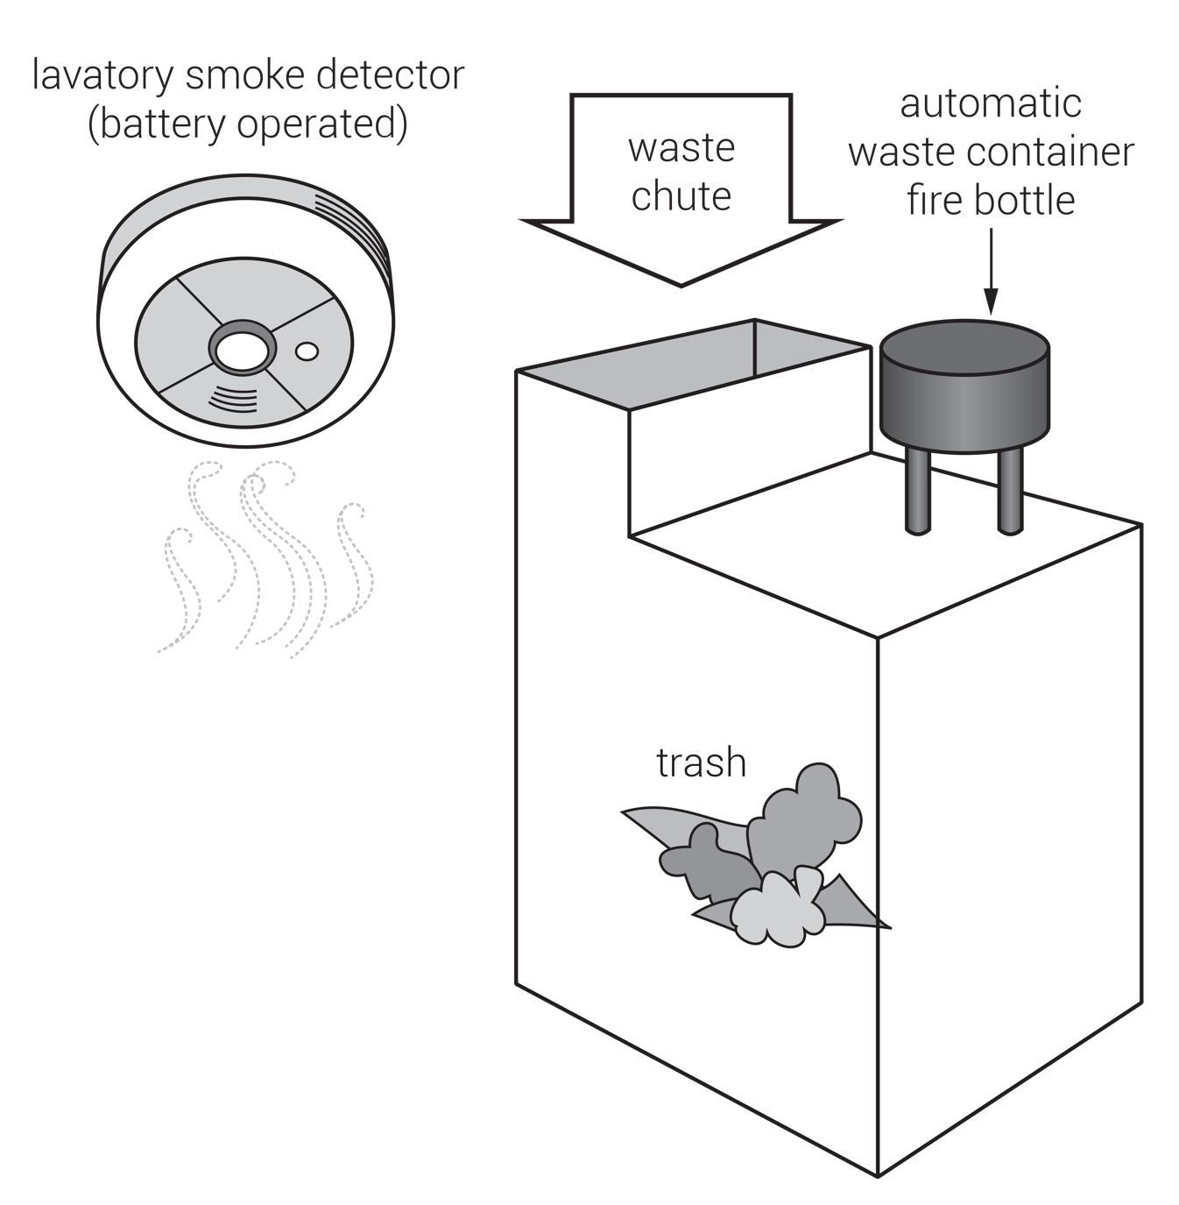
FIGURE 6.13
Lavatory fire protection.

Slide 16
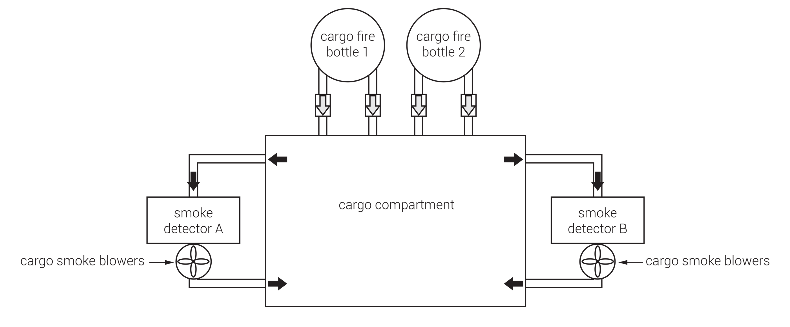
FIGURE 6.14
Cargo compartment fire protection.

Slide 17
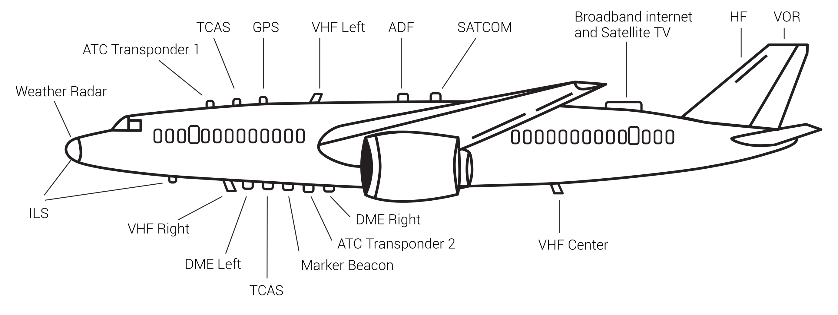
FIGURE 6.15
Typical aircraft antenna locations.

Slide 18
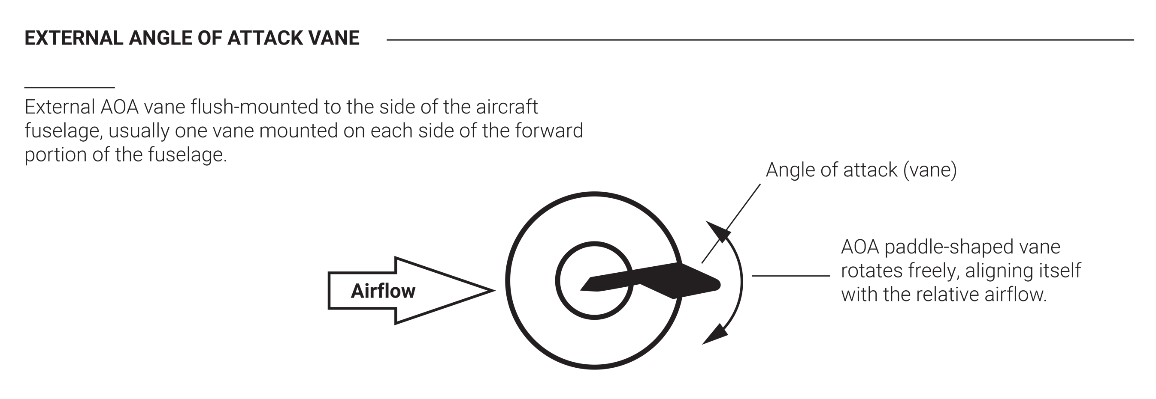
(continued)
FIGURE 6.16 (1 of 2)
Angle of attack vane and flight deck indicating system.

Slide 19
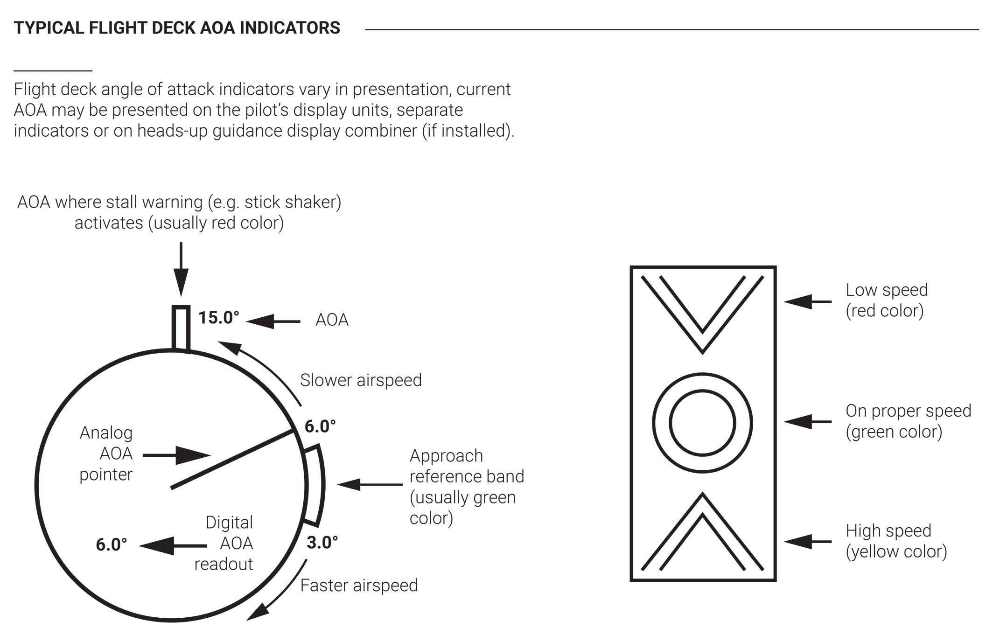
The purpose of an AOA indicator is to give the pilot better situational awareness in regards to the wing’s aerodynamic health.
FIGURE 6.16 (2 of 2)
Angle of attack vane and flight deck indicating system.

Slide 20
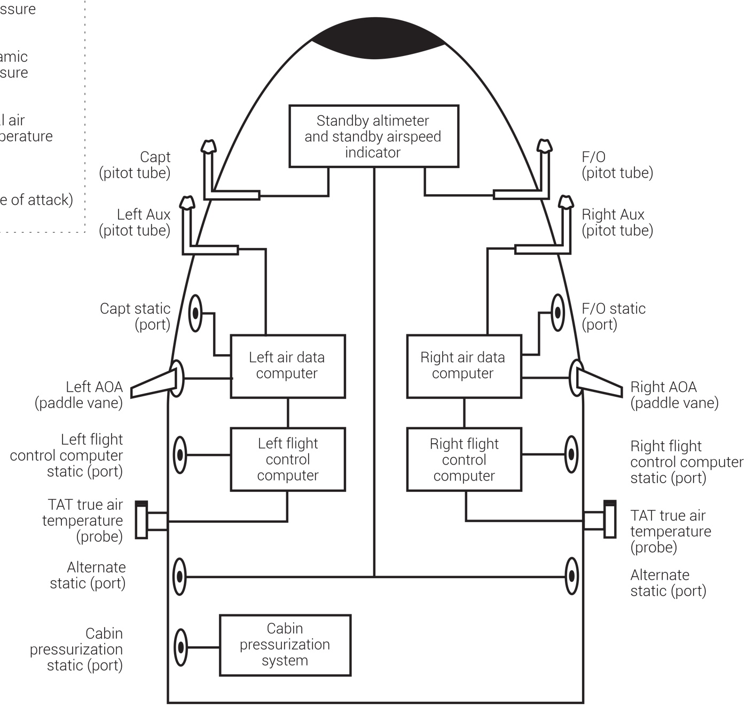
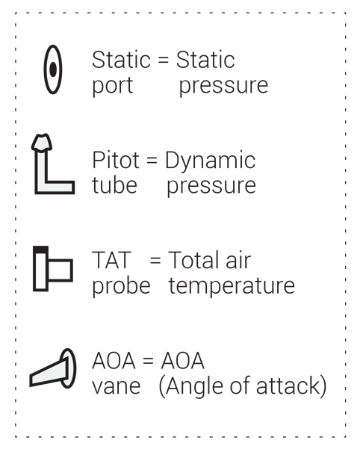
FIGURE 6.17
Typical air data computer and pitot static systems schematic.

